Slide 1

My first R package
My first R package
Tobias Busch, PhD / @tobilottii / Nordic RSE get-together / December 2020
Notes:
Why I think we should write more R packages

Slide 2
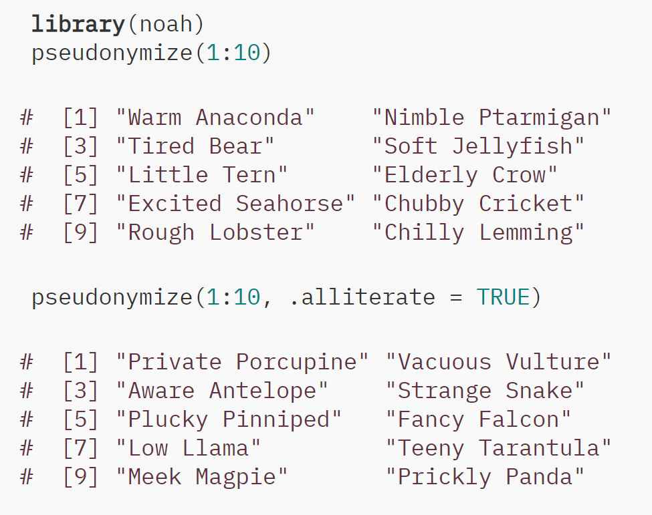

teebusch.github.io/noah
Notes:
Personal project, grown out of a script that I wrote for a dashboard to replace alphanumerical IDs and make it easier to remember interesting cases in the data
You are sitting in your HPC clusters, steering swarms of docker containers, firing particle accelerators. So why am I talking to you about this?
The topic is not my humble R package, but:
Why I believe writing a package should be a Rite of passage for aspiring RSE
How it can help improve skills

Slide 3
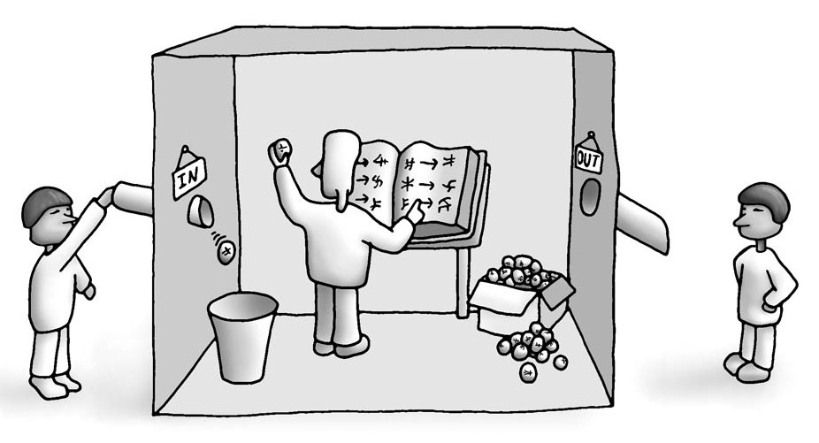




The Chinese Room
Chinese
Questions
Chinese
Answers
Research
Questions
and Data
Research
Papers
Image from Wikipedia
Notes:
As a researcher, learning to write good research software is hard.and here is why:
Imagine a native English speaker who knows no Chinese locked in a room full of boxes of Chinese symbols (a data base) together with a book of instructions for manipulating the symbols (the program). Imagine that people outside the room send in other Chinese symbols which, unknown to the person in the room, are questions in Chinese (the input). And imagine that by following the instructions in the program the man in the room is able to pass out Chinese symbols which are correct answers to the questions (the output). The program enables the person in the room to pass the Turing Test for understanding Chinese but he does not understand a word of Chinese.
plato.stanford.edu/entries/chinese-room/
A room where the blind lead the blind
Learning from each other
Apprentieship, bootstrap your RSE skills
Design sprints, Scrum masters, Kanban Boards Ticket systems, Standup meetings
The inside of the room could be other chaos, theo process totally non-reproducible, non-robust, poorly structures.--- as longa swhat comes out at the other end is apublishable research paper
Is the person in the room a RSE?
How can hey become one?

Slide 4


build a package!
How to become a (Better) RSE?
build a package!
Image by brgfx @ freepik.com

Slide 5


Shareable & Extendable
Well-structured
Robust
Different
building Packages helps you write code that’s …
R and RStudio make building packages Fun and Easy!
Image by brgfx @ freepik.com
Notes:
Write code that is

Slide 6
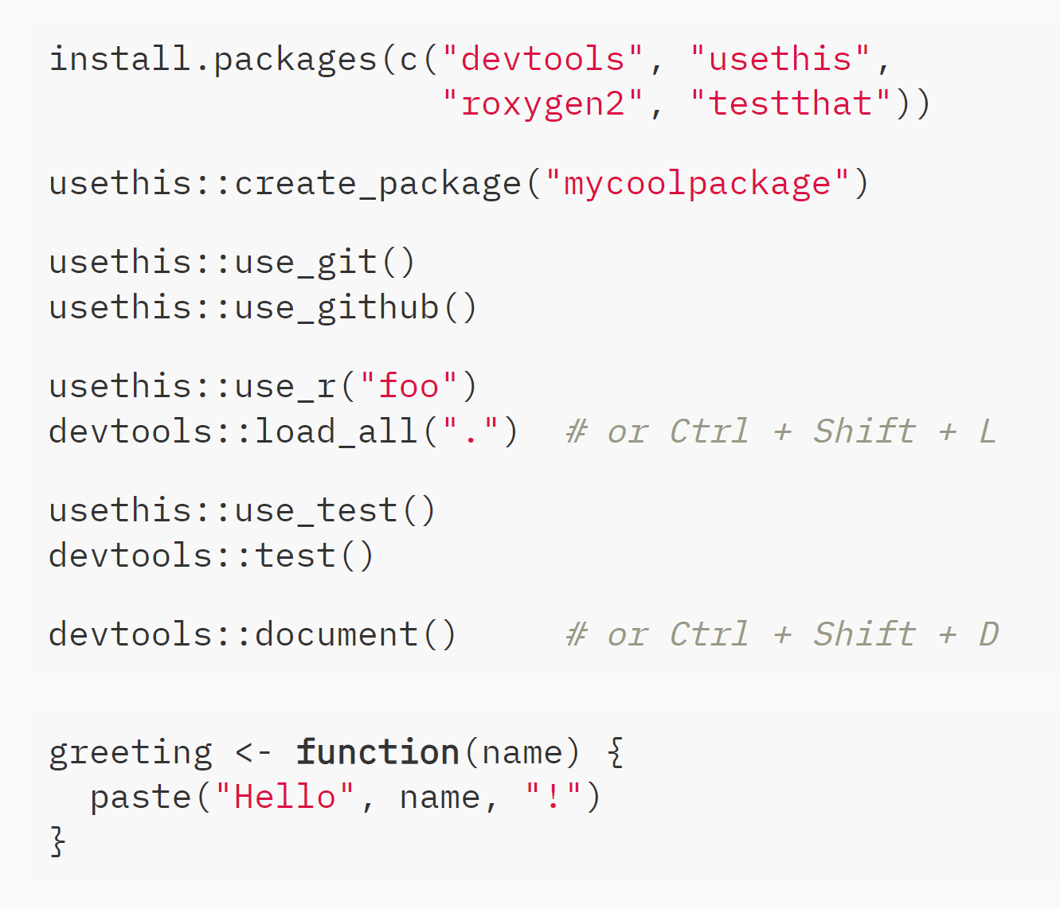
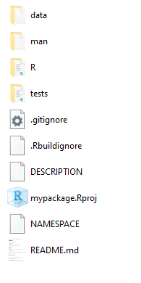
Shareable & Extendable
Well-structured
Robust
Different
File Structure
Notes:
How do R packages help you write code that is well structured…
Files tructure in R packages very close to the bast practices in data analysis

Slide 7
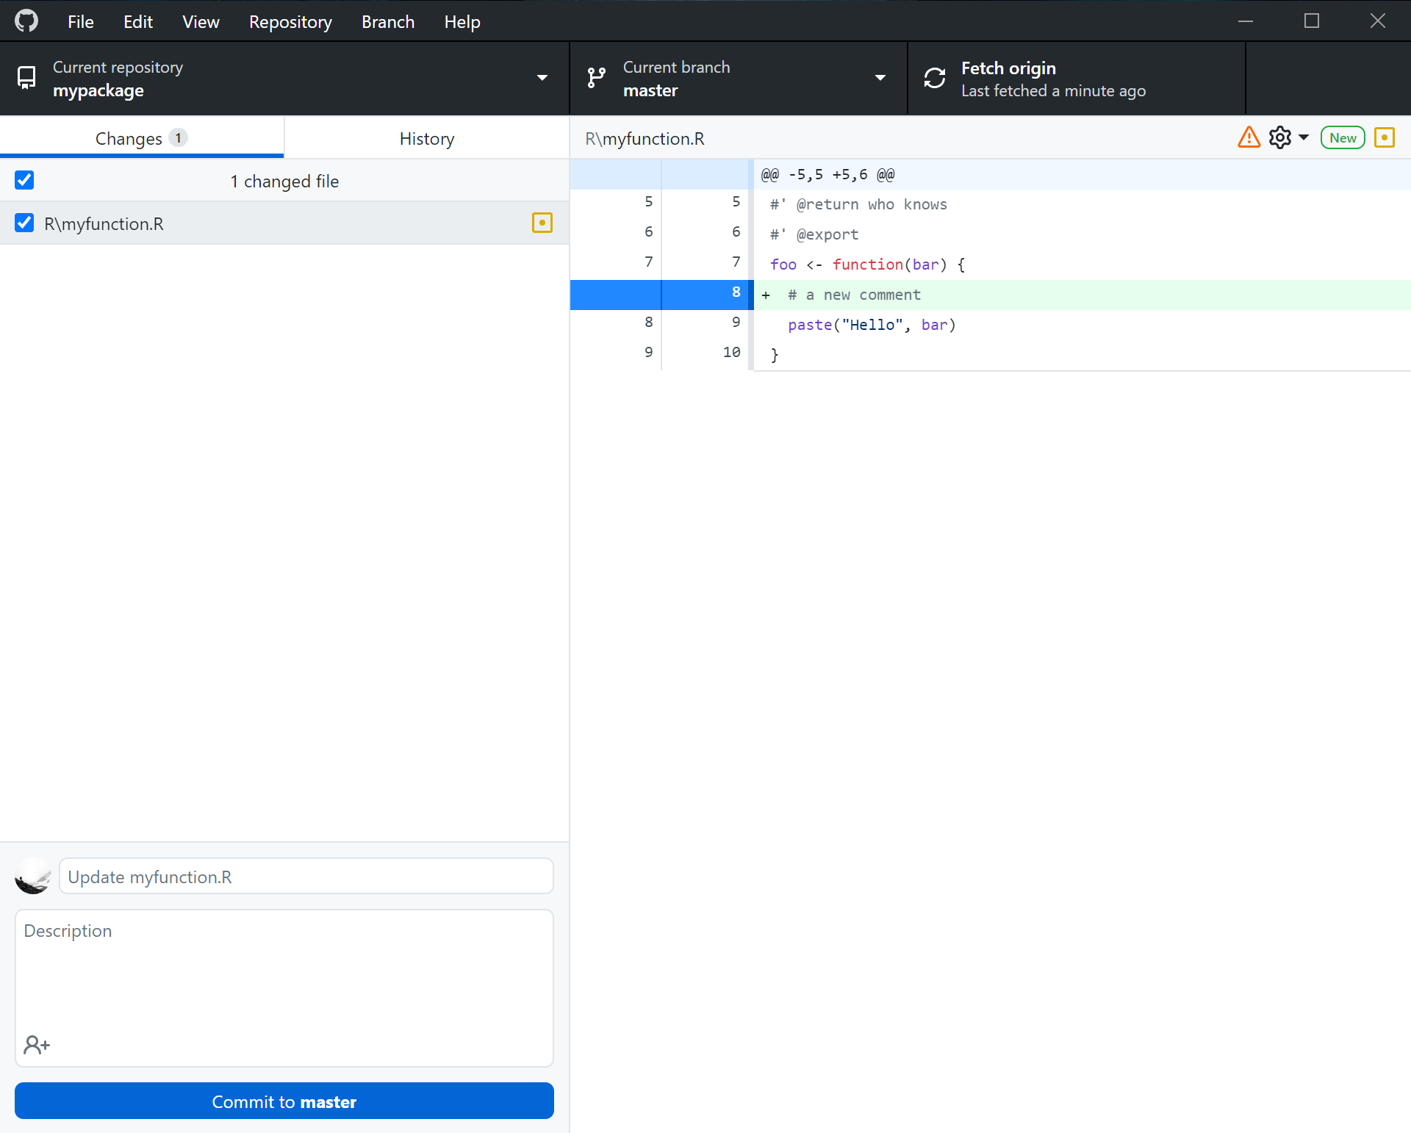




Shareable & Extendable
Well-structured
Robust
Different
File Structure
Version Control
Notes:
Using version control is easy

Slide 8
Shareable & Extendable
Well-structured
Robust
Different
File Structure
Version Control
Workflow
foo.R
Notes:
goodPreparation for workflow packags es like drak
Will make the function available in your namespace you can test drive it, platy , use it…

Slide 9
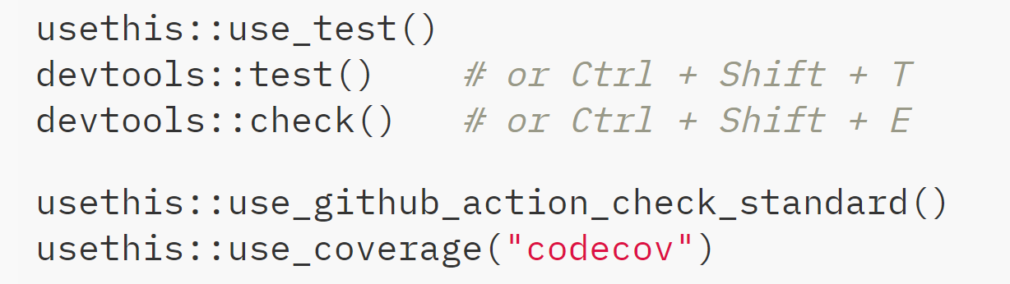
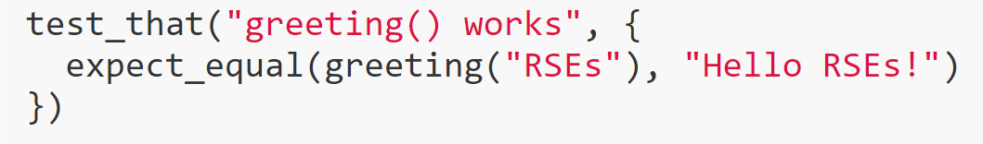

Shareable & Extendable
Well-structured
Robust
Different
File Structure
Version Control
Workflow
Testing
test-foo.R
Notes:
Turn the informal tests you do in the console into robust tests, without much overhead

Slide 10
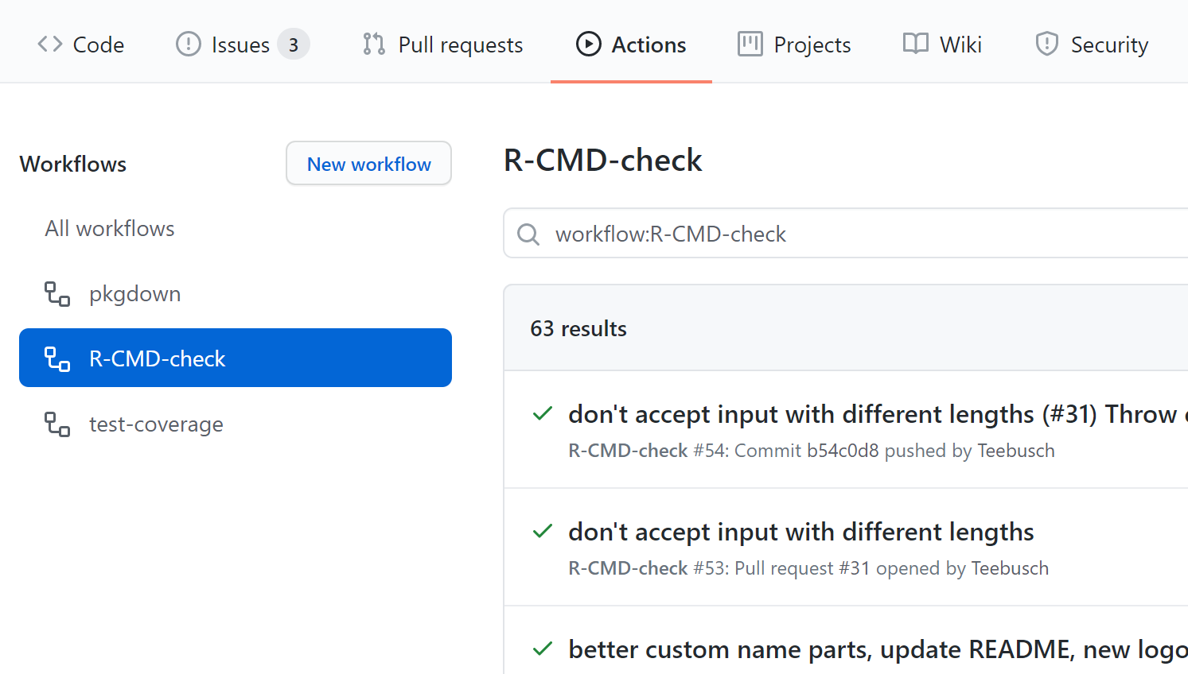
Shareable & Extendable
Well-structured
Robust
Different
File Structure
Version Control
Workflow
Testing
Continuous Integration
For more Github actions, see https://github.com/r-lib/actions/tree/master/examples
Notes:
I know little about GH actions. I know I need this one command and now whenever I make changes to master or pull requests my code gets checked with CMD CHECK

Slide 11
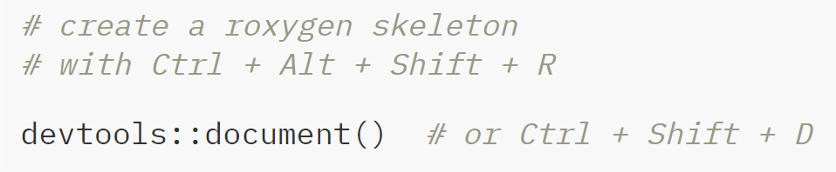
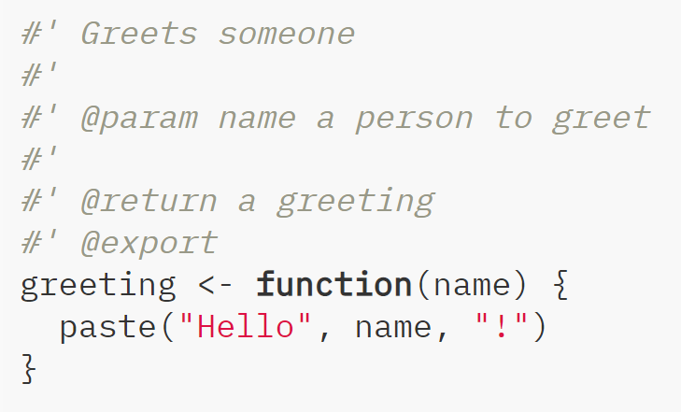
Shareable & Extendable
Well-structured
Robust
Different
File Structure
Version Control
Workflow
Testing
Continuous Integration
Documentation
foo.R
Notes:
Very powerfull. Once in place, run … and get the full ppower of R’s help functions

Slide 12
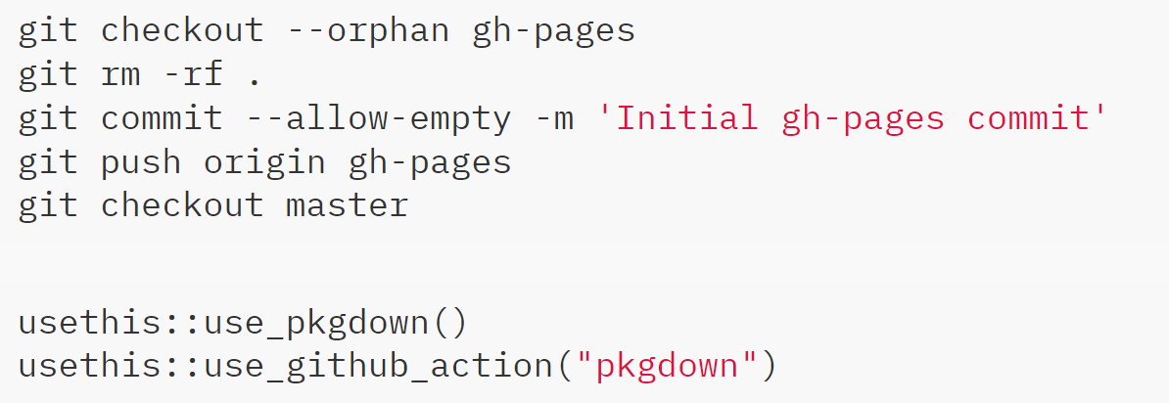
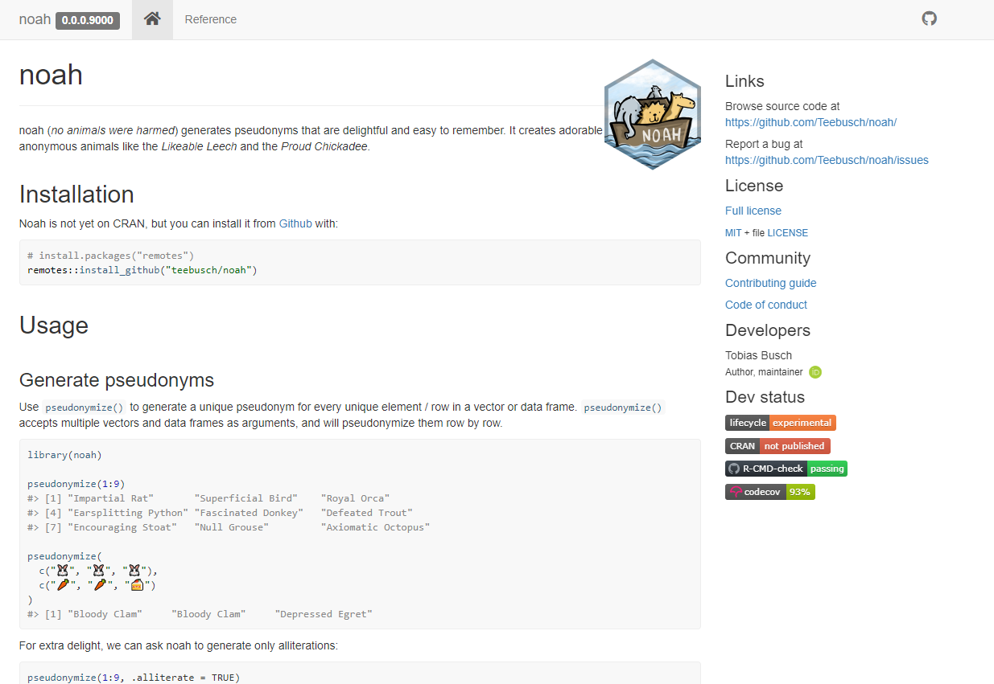
Shareable & Extendable
Well-structured
Robust
Different
File Structure
Version Control
Workflow
Testing
Continuous Integration
Documentation
More about this here: https://www.rostrum.blog/2020/08/09/ghactions-pkgs/

Slide 13
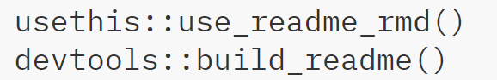
Shareable & Extendable
Well-structured
Robust
Different
File Structure
Version Control
Workflow
Testing
Continuous Integration
Documentation
Notes:
Use the power of Rmarkdown to document your packages functionality for the user

Slide 14
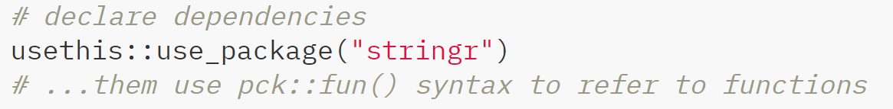
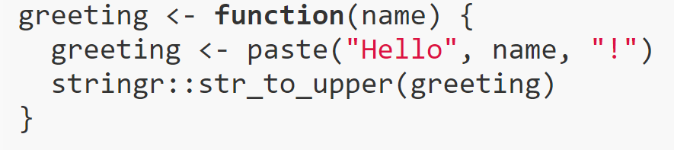

Shareable & Extendable
Well-structured
Robust
Different
File Structure
Version Control
Workflow
Testing
Continuous Integration
Documentation
Dependency Management
foo.R
Notes:
R packages force you to be explicit about dependencies
This solves some of the problems that Docker tries to solve, but low tech

Slide 15
Shareable & Extendable
Well-structured
Robust
Different
File Structure
Version Control
Workflow
Testing
Continuous Integration
Documentation
Dependency Management
Licensing

Slide 16
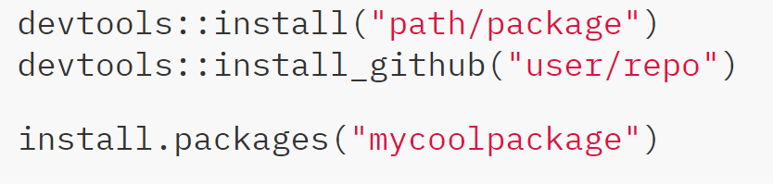


Shareable & Extendable
Well-structured
Robust
Different
File Structure
Version Control
Workflow
Testing
Continuous Integration
Documentation
Dependency Management
Licensing
Publishing

Slide 17
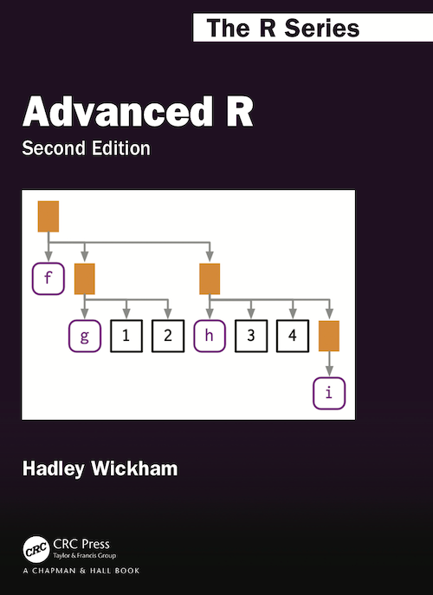
Shareable & Extendable
Well-structured
Robust
Different
File Structure
Version Control
Workflow
Testing
Continuous Integration
Documentation
Dependency Management
Licensing
Publishing
Uncomfortable Code
adv-r.hadley.nz
Notes:
Need to think differently about software architecture, OOP, functional programming, NSE, scoping
Algorithms – Fisher0Yates, RLE
If you chose a good project it requires different skills than your day job

Slide 18
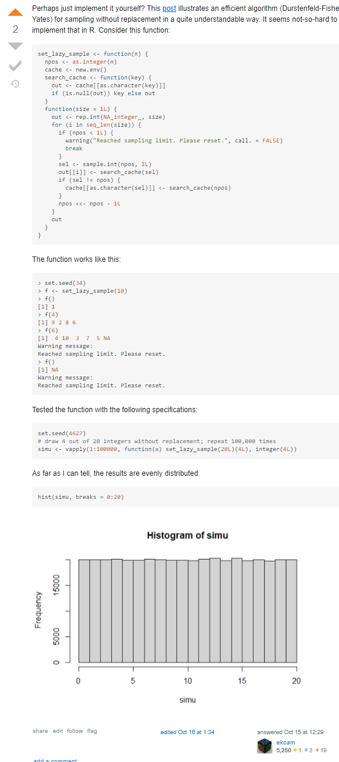
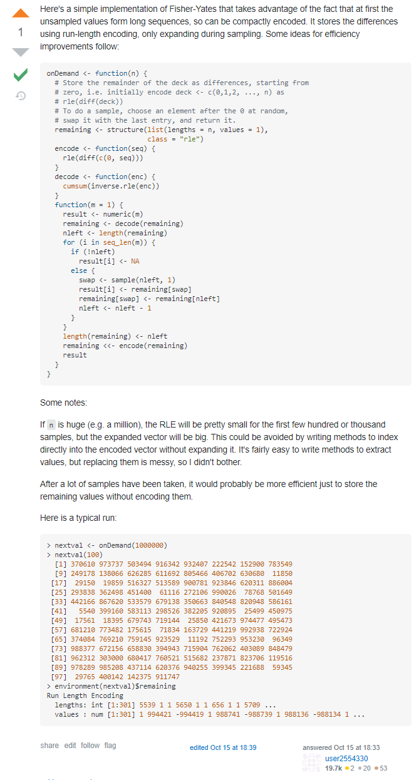
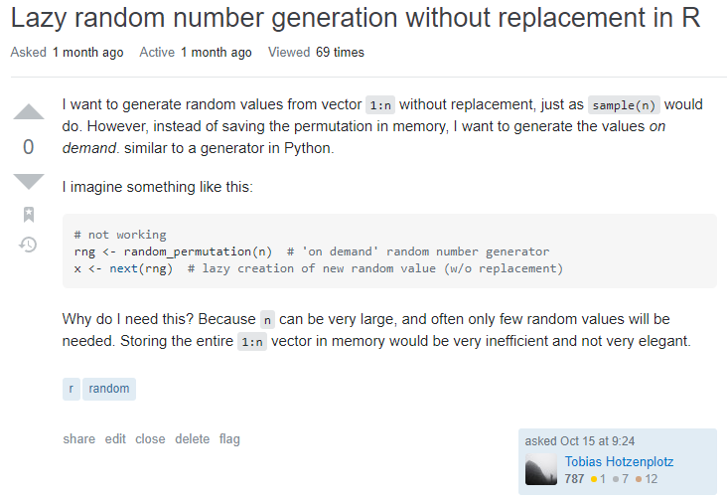




Shareable & Extendable
Well-structured
Robust
Different
Notes:
Ther’s no package for this, but the R community is awesome!

Slide 19
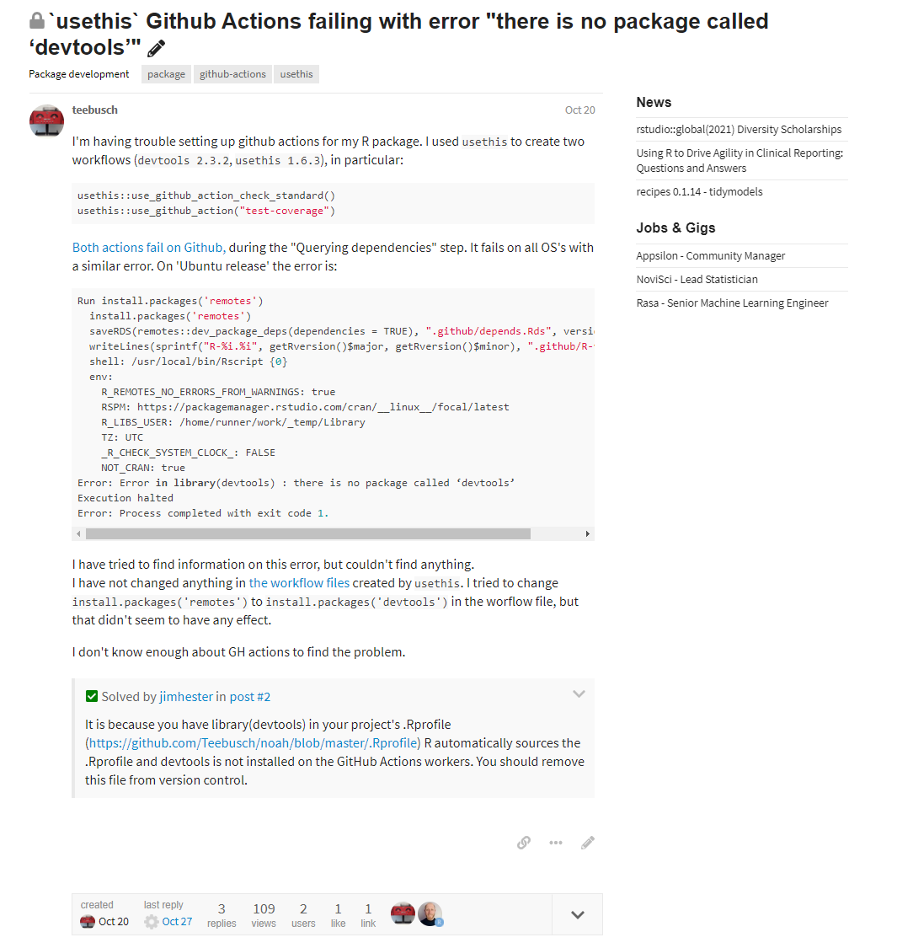
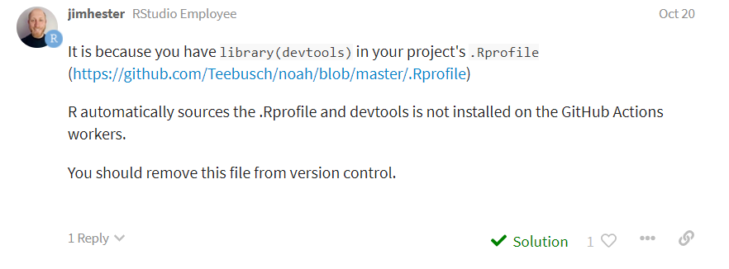


Shareable & Extendable
Well-structured
Robust
Different
Notes:
Jim is a software engineer on the Tidyverse team, with a background in Bioinformatics and Genomics. He is the author and maintainer of a number of R packages including covr, devtools, glue, readr and more...

Slide 20
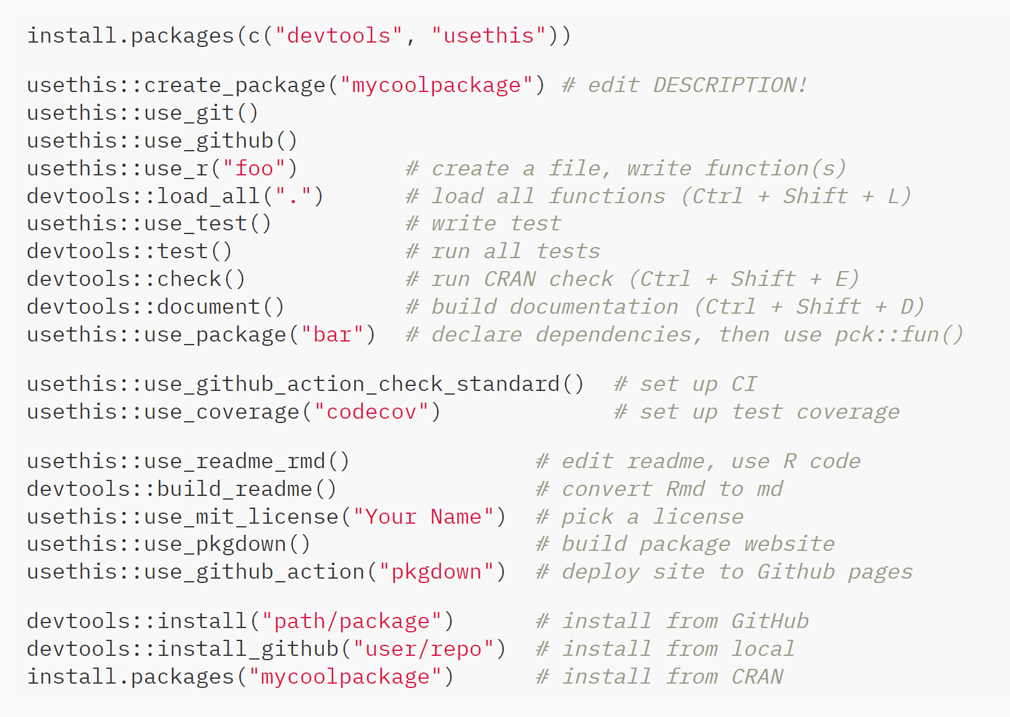
All Together now…
Notes:
This is not a tutorial.
With a few function calls you can set up the foundation for well-structured, robust, shareable and extendable R code.
Doing so allows you to try out sowtware engineering skills that you may never use in your day job, while you are locked in that RSE room.
I think this shouldbe a rite of passage for any researcher / RSE and
we should teach people how to write packages, because they enforce best practices

Slide 21
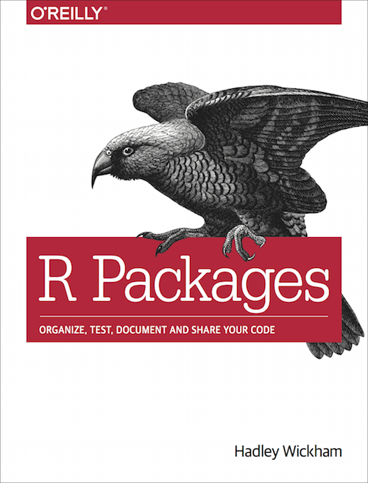


Main Packages
devtools
usethis
roxygen2
testthat
pckdown
Supporting Packages
reprex
profvis
Free Book
r-pkgs.org
Talk
Zen and the Art of R package development
youtu.be/d6JPRyp0bzY
Blog Post
Your first R package in 1 hour
pipinghotdata.com/posts/2020-10-25-your-first-r-package-in-1-hour/
R4DS Book Club
youtu.be/FR6NsbkYhcw
Notes:
If you want to give it a try yourself. The slides will be online. Also there are lots of resources!
Fantastic book
There are lots of blog posts and youtube videos. Note, that R package development has become significantly easier in the last one or two years. So look for recent stuf.

Slide 22















Tobias Busch
@tobilottii
tobiasbusch.xyz
noah
teebusch.github.io/noah
Notes:
You can contact me here,
I will tweet a link to the slides and I might eventually write ablog post about this.
And if you ever need cute random animals, you now lso know where to find them.

